Slide 1
OFFICIALS EDUCATION
Level Four
EDM CODE OF PRACTICE 2026

Slide 2
INTRODUCTION
What is EDM and how does it work?
  Electronic Distance Measure.
  Measures the distance between 2 points by sending a beam of light that is reflected off a prism and bounced back to the EDM.
  Set up so that it can use trigonometry to calculate distances from this.
RACT1.1.ICE

Slide 3
INTRODUCTION
What are the advantages of using EDM?
  More accurate, quicker to use.
  Links to other technology e.g. FEBs.
  Credibility of measurement.
  Inclusive for officials with less mobility.
RACT1.1.ICE

Slide 4
INTRODUCTION
What considerations are needed for setting up and using EDM?
  Positioning for safety of official using EDM.
  Set-up avoid having to step over legs of tripod when in use.
  Viewing for coaches and spectators e.g. not covering the take-off board.
  Able to see centre & rim / data points / arc clearly.
  Height for officials using the EDM.
  Width of legs for stability.
RACT1.1.ICE

Slide 5
INTRODUCTION
What are the potential issues that may be encountered with EDM?
  Uncharged battery.
  Knock to the tripod could require re-levelling.
  Spiker not pointing prism toward EDM machine.
  Obstruction in line of sight
  e.g. people in way, long grass, undulations in sand/ground.
RACT1.1.ICE

Slide 6
INTRODUCTION
What is the purpose of having a ‘Code of Practice’?
  Consistency across the country.
  Standardisation of use.
  Prevention of misuse.
RACT1.1.ICE

Slide 7
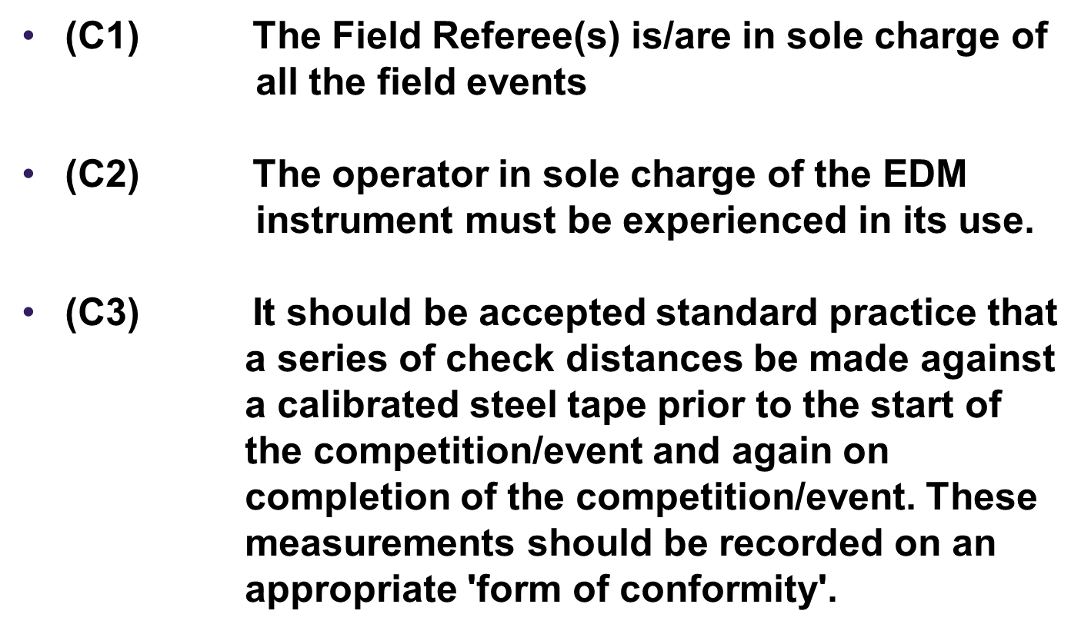
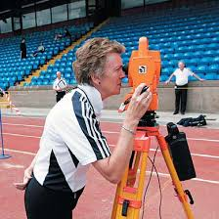
EDM CODE OF PRACTICE

Slide 8
EDM CODE OF PRACTICE
Examples of Forms

Slide 9
EDM CODE OF PRACTICE
(C4) If a New National Record or above is set –
The prism/spike should not be removed after completing the measurement.
A second prism/spike should be used to check against the previously pre-set reference points (check measure) from the start of the competition.
Then re-measure the new record distance before the original marking prism/spike is removed.
The measurement should be checked to the millimetres.
The Field Referee must be consulted/advised of the action.

Slide 10
EDM CODE OF PRACTICE
(C5) The official result card 1 will be completed by the official appointed to observe and confirm the readings taken by the EDM instrument operator.
  Card 2 will be completed by the official appointed to confirm the scoreboard display.
  A further card can be made available, for information purposes only, at the site of the event.
  To avoid any delay in the progress of the event, this card should be completed by an official not directly involved in judging the athlete's trial.

Slide 11
EDM CODE OF PRACTICE
(C6) To help avoid delays in the progress of the event, the leader should call-up the next competitor BUT not allow them into the circle/runway to take their trial before the result of the last trial appears on the scoreboard.
(C7) Officials allocated to the duties involving the use of the marking prisms must be fully conversant with their correct use and the signals from the EDM operator before the start of the event.

Slide 12
EDM CODE OF PRACTICE
(C8) All officials within the team must be made fully conversant with the signal to be used to indicate that the EDM reading has been concluded.
(C9) Any type of communications equipment must be monitored for reliability both before and during the meeting. Preferably, a channel should be reserved for the use of the EDM team exclusively if the equipment is not situated adjacent to the event.

Slide 13
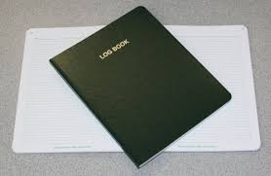
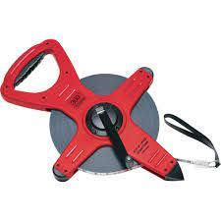
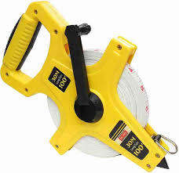
EDM CODE OF PRACTICE
(C10) A logbook detailing the servicing
and maintenance of the EDM
instruments should be kept.
A current calibration certificate should accompany the EDM machine.
(C11) As a precautionary measure, a steel
or fibreglass tape should be kept
available at the event in case of
malfunction of either the EDM or
communication equipment.

Slide 14
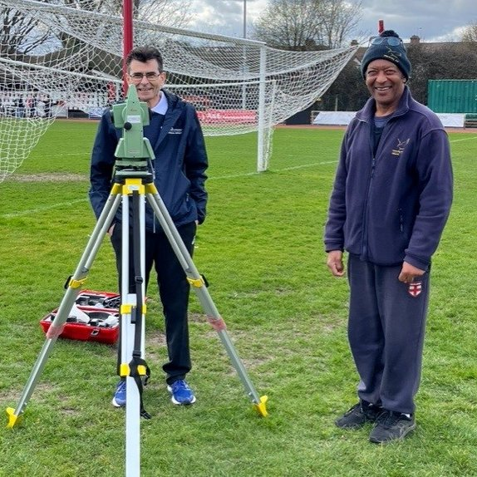
EDM CODE OF PRACTICE
EDM Set-Up Video -
https://www.mafeo.net/Downloads/EDM/EDM_Setup1.mp4

